Slide 1
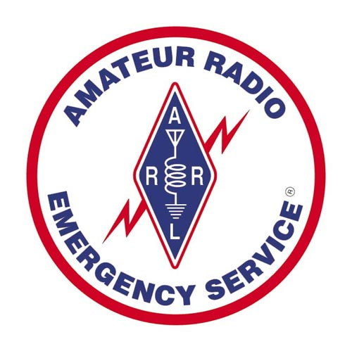
ARES Net Control Operator Workshop March 02, 2024
Workshop Leader: Douglas Sharafanowich, WA1SFH
District Emergency Coordinator
ARES: CT Section – Region 2

Slide 2
ARRL - ARES Net Control Operator Workshop (03/02/24)
What is a Net Control Station?
A Net Control Station (NCS) is an operator responsible for controlling all radio traffic on the Repeater or HF Freq during a “Directed Net”.
The NCS should view themselves as an
Emergency Dispatcher.
The NCS needs to remain professional at all times
and needs to maintain a calm collected demeanor.

Slide 3
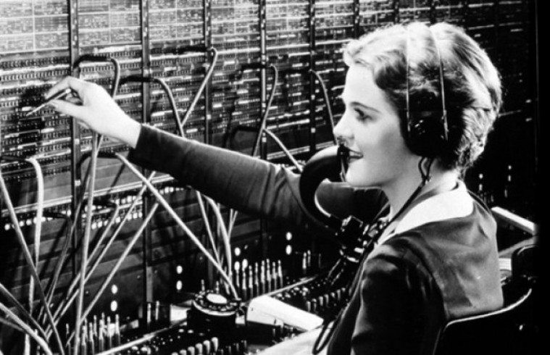
ARRL - ARES Net Control Operator Workshop (03/02/24)

Slide 4
ARRL - ARES Net Control Operator Workshop (03/02/24)
MISSION:
GET
The Right Information
At the Right Time (To our served “Agencies”)
To Make the Right Decisions

Slide 5
ARRL - ARES Net Control Operator Workshop (03/02/24)
To the untrained Operator,
a Net can seem like this.
OSK Fly-In - ATC Comms https://youtu.be/toTXCaa0A-0

Slide 6
ARRL - ARES Net Control Operator Workshop (03/02/24)
When in Trouble
Or in Doubt
Run in Circles
SCREAM and SHOUT

Slide 7
ARRL - ARES Net Control Operator Workshop (03/02/24)

Slide 8
ARRL - ARES Net Control Operator Workshop (03/02/24)
The Reality is that in ARES,
in order to Handle The “Excitement”,
We
Build SKILLS
Develop METHODS
Establish PROCEDURES
To Get The Job Done

Slide 9
ARRL - ARES Net Control Operator Workshop (03/02/24)
4 TYPES OF NETS
Open (lightly moderated) Nets
Regular Weekly (Formal*) Nets
Public Service Event (Formal*) Nets
Incident / Emergency / Disaster
(Oh, SHIT!*) Nets
* “Directed” Nets

Slide 10
ARRL - ARES Net Control Operator Workshop (03/02/24)

Slide 11
ARRL - ARES Net Control Operator Workshop (03/02/24)
From Tactical Net

Slide 12
ARRL - ARES Net Control Operator Workshop (03/02/24)
KEEPING TRACK
with
ICS FORMS

Slide 13
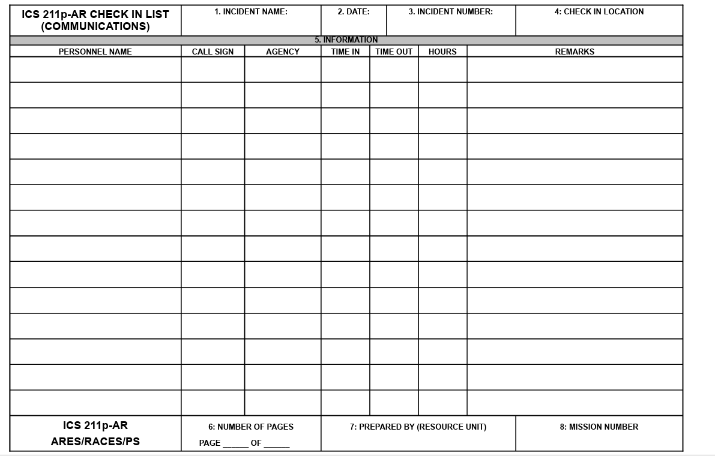
ARRL - ARES Net Control Operator Workshop (03/02/24)
ICS-211: Check In Sheet.
This form is commonly used to record the names and pertinent info as workers enter or leave an incident scene. The Amateur Radio specific version of this form includes a column for callsign and eliminates some unneeded info.
This form will keep you on track on who is active as stations check-in and check-out of the net.

Slide 14
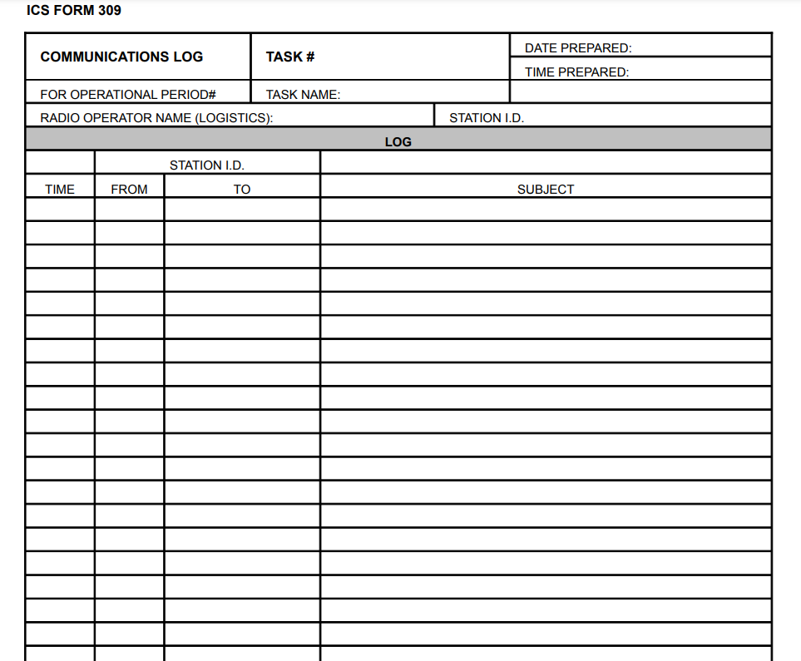
ARRL - ARES Net Control Operator Workshop (03/02/24)
ICS-309: Log Sheet.
Another ICS form that has been customized for amateur radio use.
This form has columns for recording time, stations, and callsigns.
This is your running record of events that have transpired on the net.

Slide 15
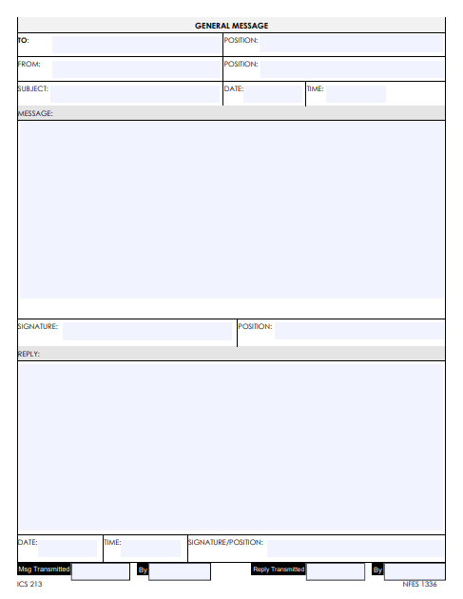
ARRL - ARES Net Control Operator Workshop (03/02/24)
ICS-213: Message Form.
Often you’ll be required to pass a piece of traffic to another party, like an event organizer or official. Writing the message on a piece of scratch paper may seem convenient, but opens the door for errors and incomplete messages. Using the ICS-213 message form is a standardized method to record a piece of traffic and the response of the recipient. Is this form necessary for every piece of traffic on the net? No, it isn’t.
But, if the traffic requires a response from a third party, this form will become invaluable.

Slide 16
ARRL - ARES Net Control Operator Workshop (03/02/24)
SUPPLIES In addition to these forms, other items that are useful for your net control activities include:
Scratch Paper
Bound “Composition Book”
Pens and Pencils
Maps (Hagstrom, Delorme Gazetteer, Rand McNalley)
Google’s online map … if you still have Internet
Binder (To keep extra blank Forms and Ruled Paper)
Clipboard (or 2)
Clock

Slide 17
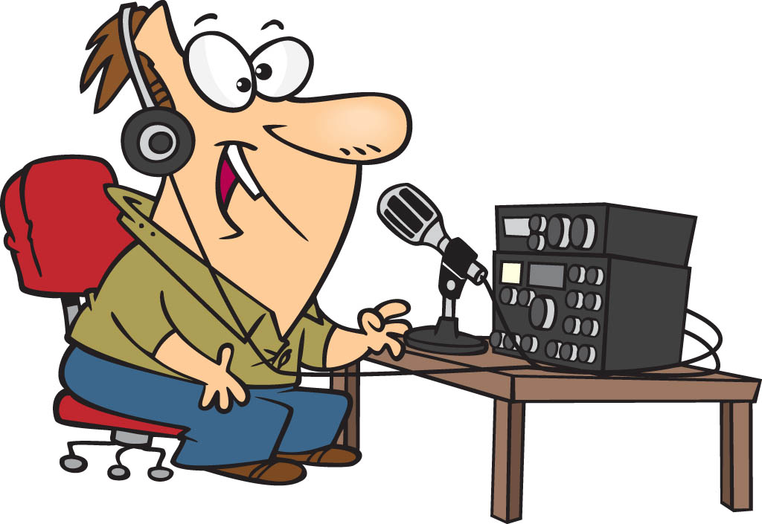
ARRL - ARES Net Control Operator Workshop (03/02/24)

Slide 18
ARRL - ARES Net Control Operator Workshop (03/02/24)
19 ATTRIBUTES OF A GOOD NCS OPERATOR…..
1. Good communications skills and fluent command of our language
2. Good voice quality
3. Good hearing capabilities
4. Good listening capabilities
5. Good ear-to-hand copying skills
Understands what SERVICE means
Has good knowledge of the ICS
8. Willing to take and carry out direct orders
9. Is a strong team player
10. Is Self-assured but not overbearing
11. Decisive, with the maturity to make good judgment calls
12. Physically able to tolerate high stress for extended periods
13, Constant concern for the safety of participants
14. Organizer
15. Sense of humor
16. Ability to absorb new terminologies quickly
17. Decent (readable) penmanship
18. Generally neat of appearance
19. Consistently demonstrates above average operating techniques

Slide 19
ARRL - ARES Net Control Operator Workshop (03/02/24)
NCS QUESTIONS…..
The following is a list of questions an NCS operator needs to ask of themselves BEFORE starting a net. If you cannot answer at least two thirds of the questions in the affirmative, you should seriously consider having some one else run the net. Exceptions to these are daily to weekly scheduled nets and those should still consider many of the items.
1. Is the NCS location away from the Command Post (CP) or EOC?
If not, it should be. The noise and commotion at CP/EOC degrades your ability to run a good net and the noise you generate only adds to the confusion there.
2. Are you using a headset with noise canceling microphone?
You really should. Even from home the background noise will affect h well you can hear and be heard.
3. Do you have the best performing antenna for the conditions?
A “rubber duck is not adequate unless you can see the repeater antenna. That does not mean see the mountain the repeater is on, it means see the antenna.
4. If you are running from battery: Do you have at least enough charge on the battery to run more than one hour?
You should have a battery with 90+% charge but if you are the only choice for NCS then make sure you can run the net long enough to have someone else get ready.
5. Do you have pencil/pen and paper sufficient to run the net for a full shift?
You will NOT be able to remember enough of the information to be effective unless you write it down. It is up to you to maintain the log for the event/incident unless you have an assistant to handle that assignment.
6. For VHF/UHF: Do you know the characteristics of the repeater system you are on?
Your effectiveness as NCS will be adversely affected if you do not
7. Do you have a runner- liaison or logging person to support you?
For large scale events three people are needed. You cannot handle the net, log and run messages. These positions may be rotated to eliminate fatigue.
8. Do you have a designated relief operator?
Everyone gets tired, and the NCS must be the most alert operator on the net.

Slide 20
ARRL - ARES Net Control Operator Workshop (03/02/24)
LEARNING TO BE A NET CONTROL STATION (NCS)…..PART 1
Many of the skills used in contesting are applicable to NCS. Both activities involve coordinating several stations on the same frequency at the same time. The similarity ends there. Where the contester is in a hurry, NCS is calm and almost seems to be going very slowly. The extra time NCS uses actually speeds information flow by minimizing repeats and ensuring that priority information has access to the net without needing the largest signal on the Net.
NCS techniques include:
>>> Have the best performing antenna for conditions. A ‘rubber duck’ is not adequate unless you can see the repeater antenna. That does not mean see the mountain the repeater it is on. It means see the antenna (Line of Sight)
>>> A good Log is critical to an efficient operation. Create and use a good log. A few calls scribbled on a sheet of paper, in no real order, becomes useless in a few seconds.
Make sure your log includes: 1) Time of the entry 2) Call / Tactical call 3) Summary of what was said or requested.
Be sure not to kill yourself with excessive details. The log is an overview of who did what, where and when.
>>> Plan what you are about to say as if you will be quoted. - PTT does not mean Push Then Think.
>>> DO NOT make “Editorial comments” about the business or information being passed unless it will speed or enhance the information flow! Chattiness, especially early in the Net, degrades the effectiveness of the Net.

Slide 21
ARRL - ARES Net Control Operator Workshop (03/02/24)
LEARNING TO BE A NET CONTROL STATION (NCS)…..PART 2
>>> Be as concise as possible. Use the fewest words that will completely say what you mean. This will minimize the need for the repeating of instructions.
>>> Slow Down! Wait three or four seconds before you answer any call. This assures any emergency or priority traffic has access to the net without requiring the largest signal.
>>> When asking for reports or soliciting traffic, listen! Take down as many calls as you can identify before you acknowledge anyone!
>>> When there is a double, try to get something unique from one or more of the stations. Then call for clarification from those stations ONLY. The alternative approach is to acknowledge the check-ins you could understand and then call for Check-Ins that tried in the last round but were not acknowledged. The very worst thing you can do is to say “The station that doubled with ..?? How are they to know who they doubled with?!
>>> When acknowledging Check-ins, list the call signs as letters (not phonetically).
The purpose of this acknowledgment is to confirm to each check in that his/her call was heard. Phonetics used on all acknowledgments simply slows the net.
NOTE: Phonetics are an excellent way to clarify questions about the call received (was that a B or a D, etc.). Reciting all of the check in information beyond the call simply wastes time.

Slide 22
ARRL - ARES Net Control Operator Workshop (03/02/24)
LEARNING TO BE A NET CONTROL STATION (NCS)…..PART 3
>>> Acknowledge all stations that you heard, then yield the frequency to a single station.
When that station is finished, hand the frequency to the next station on the priority list, without soliciting more traffic. Follow this pattern until you’ve completed your list, then repeat. The exception to this is when handling routine traffic during an emergency. With routine traffic during an incident net, break between messages to solicit any emergency/priority traffic and handle that first.
>>> The NCS callsign, should be announced several times at the beginning of the net and every eight to ten minutes during an exchange. Many NCS’s use the repeater ID’er to track the time to identity.
>>> For scheduled nets, NCS’s goal should be to run the script top to bottom and handle all of the listed business, announcements and traffic as quickly as possible, without rushing.
>>> Most participants will catch on quickly to the pattern. If they do not, take the time to explain. Things get done much faster if everyone uses the same techniques.

Slide 23
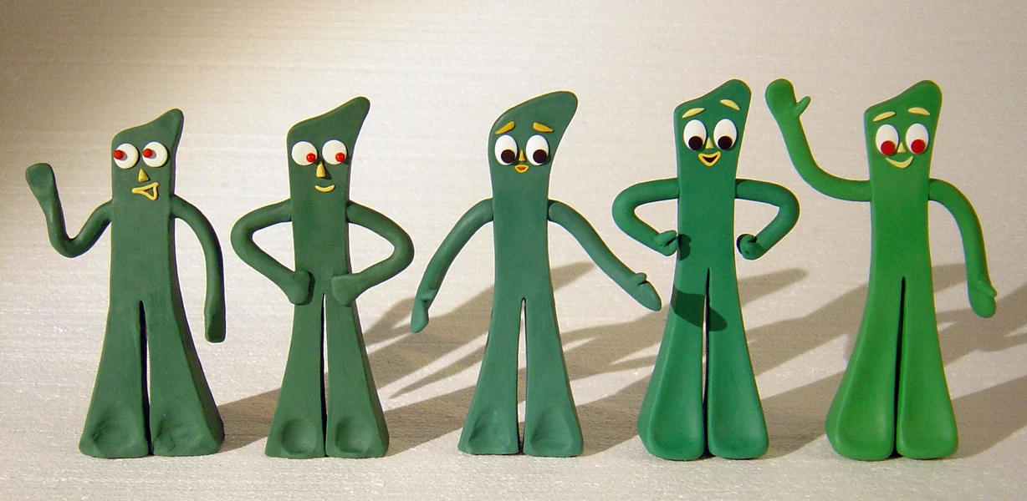
ARRL - ARES Net Control Operator Workshop (03/02/24)
SEMPER GUMBY !

Slide 24
ARRL - ARES Net Control Operator Workshop (03/02/24)
LEARNING TO BE A NET CONTROL STATION (NCS)…..PART 4
>>> Take frequent breaks. While you may not recognize the stress that being an NCS produces, it will become evident in your voice. If you are asking yourself when your last break was, you know it is time for one. Turn over the net to your backup at least every two hours and REST. Do not listen to the net. Rest. Then, when rested, listen to the net for a few minutes before resuming your station.
>>> Control the tone of your voice. Be as calm as possible. Tension tends to make our voices raise in pitch and this change will be picked up by the net. Use a calm tone and members of the net will tend to remain calm.
Last and FAR from least …
The ability to remain Cool, Calm and Collected will buy you more than anything else.
There is no doubt that being an NCS is a high pressure assignment and it is easy to become frustrated or angry. If you have a frustrating problem, ask for help from other members of the Net.
Source: https://www.k7yca.org/how-to/hints-for-being-net-control-4/

Slide 25
ARRL - ARES Net Control Operator Workshop (03/02/24)
Q & A
Time

Slide 26
ARRL - ARES Net Control Operator Workshop (03/02/24)
Time for a
10 minute
BREAK

Slide 27
ARRL - ARES Net Control Operator Workshop (03/02/24)
NCS Standard Operating Guidelines
1. While serving as the net control station, you maintain total responsibility and authority in providing a smooth running net. The NCS, however, must accept any direction, guidance, or changes given by the GC-ARPSC Lead Operators.
2. Remember that you are “In Charge”.
Do not allow any arguments or unregulated operating to take place.
Often, in emergencies, nerves become frayed and tempers can get short.
Operate as a Peacemaker and calm people down.
Remember that your tone of voice is the most powerful part of your speech.
3. Give the TIME frequently.
4. When transmitting, be sure to “hang back” after the courtesy tone, in order to give stations a chance to break in. During emergency nets things can happen quickly. So be prepared to handle yourself in a controlled manor.

Slide 28
ARRL - ARES Net Control Operator Workshop (03/02/24)
5. In times of critical emergency or a high traffic load, it is recommended that you appoint a backup net control station, to be sure all information is properly recorded and that if you suddenly have to transfer net control there is an operator already in place.
6. All your transmissions must be in a controlled and clear voice.
This will help maintain control and ensure that all operators understand your transmissions.
7. At no time should you argue with a Lead Operator.
If a disagreement occurs, either handle the conflict through a more private medium (email, phone, or, in extreme situations, on an alternate frequency) or wait until later.
b) Those involved in the net and the scores of additional hams and others who are monitoring need to see you as a unified team.

Slide 29
ARRL - ARES Net Control Operator Workshop (03/02/24)
8. Remember that, in compliance with FCC regulations, you must “ID” (identify your station by call sign) every ten minutes if you involved in constant communications or using tactical call signs.
9. Deactivation of all nets will be in conjunction with the NCS and the IC of the emergency incident or event. Once the net is concluded the repeater/s must be returned to normal amateur use.
10. The NCS operator shall keep a documented log of all transmissions taking place during the net. This is preferred to be typed, but can be hand-written in an emergency situation. (e.g. Composition Book). Log should record the time, which operator is calling the NCS, and a brief synopsis of the transmission.
11. The NCS or Lead Operator will have discretion to alter the order at which what back up repeater or Simplex frequency is used so it best fits the needs the incident.
12. The backup NCS shall periodically check the 2m alternate repeater to announce the active net on the 2m Primary/ 2m Linked repeater and request operators if needed.

Slide 30
ARRL - ARES Net Control Operator Workshop (03/02/24)
Operating Guidelines for Handing Difficult Operators
If any complications or confusion occur during the net, do not handle it during the emergency.
This must wait until after the emergency has ended.
Sometimes you will get uninformed or irresponsible reports during nets, such as “This is (CALLSIGN) well, the clouds are getting darker over this way and it is starting to rain.”
Don’t respond with critical remarks.
Politely acknowledge their transmission and, if there is not a great deal of activity, you may be able to explain the type of report we are looking for.
You may have operators check in and request assignment who are unqualified.
Do not be rude. Just explain to them that they do not meet the requirements, and see if there is another assignment they can fill.
Have any operator with complaints contact the SEC or his designee.

Slide 31
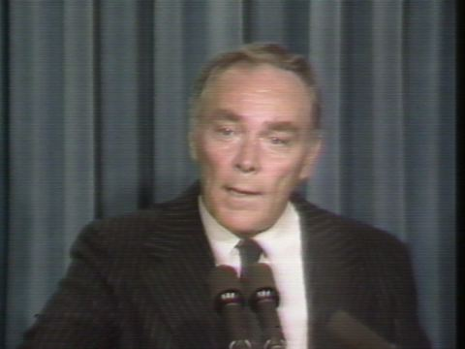
ARRL - ARES Net Control Operator Workshop (03/02/24)
Al Haig

Slide 32
ARRL - ARES Net Control Operator Workshop (03/02/24)
How to Assume and Turn Over Net Control
At the time you are to assume net control, make a contact with the current NCS and notify them that you are ready to take over.
Be sure that you have received the information you need in order to assume Net Control.
This would include:
1. Current weather advisories, watches and warnings (for SKYWARN).
2. Current operators logged into the net and their assignments and tactical call signs.
3. Current operational level of the Net.
During the Emergency Net, the NCS shall conduct status checks on operators who they have not had any radio contact with the past 30 minutes. (MIA)
This can be done at shorter intervolves if the NCS deems it necessary.
During the Fire Coordination, if an operator states they are in an emergency situation the NCS shall hold all radio traffic not related to the emergency on the repeater until the emergency is resolved.
Once the emergency is resolved the NCS shall resume normal net operations.

Slide 33
ARRL - ARES Net Control Operator Workshop (03/02/24)
PROWORDS AND INTRODUCTORY WORDS/PHRASES
“Do what the trained receiving operator expects, and confusion and errors will be minimized.”
– from “Methods and Practices Guidelines (MPG)”
Use of prowords and introductory phrases are used in message handling to enhance accuracy and efficiency. They are not part of the message itself and are not counted in the check, but are spoken to begin or end the message, indicate information for the receiving operator, or to separate parts of the message or books. Detailed information can be found at
http://www.arrl.org/files/file/Public Service/MPG204A.pdf.
NUMBER
Tells receiving station to copy everything after hearing word “Number”
BREAK
follows address to indicate beginning of text and again at end of text before signature, ALSO used to separate parts of booked messages

Slide 34
ARRL - ARES Net Control Operator Workshop (03/02/24)
END
Indicates end of the message, to be followed by END NO MORE (no more messages for you or END MORE or END # MORE referring to number of messages to follow.
BOOK OF #
Used to begin transmission of a book of messages.
To begin the book say “BOOK OF (#)” then begin the fixed parts of the message.
The corresponding words to end the book are “END BOOK”. The (#) is the quantity of individual messages in the book spoken as words without using the “figures” introducer.
I SPELL
Used to indicate you are going back to spell the group just voiced.
It is used with ONE GROUP AT A TIME, and is said IMMEDIATELY after voicing the group, followed by either phonetic or letter spelling of the group.

Slide 35
ARRL - ARES Net Control Operator Workshop (03/02/24)
I SAY AGAIN
Used to indicate you are going back to spell the group just voiced. It is used with ONE GROUP AT A TIME, and is said IMMEDIATELY after voicing the group, followed by either phonetic or letter spelling of the group. OR to correct an error, Stop, say “I say again”, go back to last group (or proword) sent correctly, and continue, starting with that correct group or proword.
AFFIRMATIVE
Yes
NEGATIVE
No
ROGER
Received and understood.
*** Does NOT mean yes, confirm, or affirmative! ***
Always used at end of message to acknowledge 100% receipt of message.

Slide 36
ARRL - ARES Net Control Operator Workshop (03/02/24)
INITIAL
Used to introduce a single letter initial, phonetic pronunciation mandatory, as in the initial in a proper name, John R Smith: “JOHN.. initial ROMEO.. SMITH”
INITIALS OR LETTER GROUP
Used to introduce a group of 2 or more letters, as in an abbreviation, unpronounceable group, etc. Phonetics are mandatory; as in: AM voiced as “initials ALPHA MIKE”
FIGURE(S)
Used to introduce a group of one or more numbers:
Say “figure(s)”, then voice the numbers one digit at a time, group pause, and go on to the next group. Examples: 2, voiced as “figure TWO”; 62, voiced as “figures SIX TWO”

Slide 37
ARRL - ARES Net Control Operator Workshop (03/02/24)
MIXED GROUP
Used to introduce a group consisting of a mix of 2 or more of the 3 types of characters permitted in a group; letters, figures, or slashes (/), not beginning with figure(s). R2, A3J, A/X, B/3, MS/4, W4XYZ/3, W3XYZ/EPA/EANTX, etc .
Do NOT introduce characters separately within the mixed group.
To do so would imply a separate group to copy
MIXED GROUP FIGURE(S)
Used to introduce a mixed group as above when the first character is number(s), as in:
2A: voiced as “mixed group figure TWO ALPHA”
AMATEUR CALL
Used to introduce an amateur call sign in the Address, Text, or Signature (but not in the Preamble). Phonetics are mandatory for the letters; as in: KO0O:
voiced as “amateur call KILO OSCAR ZERO OSCAR”, etc.
Source: https://ema.arrl.org/prowords-and-introductory-words-phrases/

Slide 38
ARRL - ARES Net Control Operator Workshop (03/02/24)
Q & A
Time

Slide 39
ARRL - ARES Net Control Operator Workshop (03/02/24)
Time for a
10 minute
BREAK

Slide 40
ARRL - ARES Net Control Operator Workshop (03/02/24)
The First 15 Minutes
The Clock Starts at Zero (00:00)
The Telephone Rings!
Your EC just woke you up in the middle of your favorite TV sporting event.
He wants you to start an emergency net from your shack.
He is at the EOC.
There is a ruptured Gas Main in a heavily populated part of town.
Other than the location, he didn't give you any more information.
You head for the shack, turn on the 2m/440 rig, and grab a clipboard.
Your training kicks in.
You begin asking yourself questions and writing down the answers.
OK, broken Gas Main ...
Police, Fire, Gas company, and Emergency Management involved ...
possible evacuation ...
possible need to open shelter ...
transportation possibly needed ...
likelihood of handicapped people in the area ...
danger of asphyxiation ...
might go all night

Slide 41
ARRL - ARES Net Control Operator Workshop (03/02/24)
The First 15 Minutes
Think! Think! Think!
1. What kind of Net should I start? Open? Directed?
2. How many people am I likely to need?
3. How long do I estimate the event will last?
4. Do I need to hold some people in reserve for a Shift change?
5. What agencies are likely to be involved?
A. Do we have special Liaison people for these agencies?
6. Do I have any operators who live in the affected area?
7. Which way is the wind blowing?
8. What will be the safest route into the area?
Don't have enough information.
- EC said he will call back with more.

Slide 42
ARRL - ARES Net Control Operator Workshop (03/02/24)
The First 15 Minutes
Better find out what I have available right now.
Pick up the mike and announce that there is an emergency
situation developing. Use OPEN format standby net.
Take check-ins.
Ask two operators to go to other local repeaters and recruit people for the
upcoming net.
Check-ins begin coming in.
Advise everyone to prepare for participation assignments.
Recruit someone to come to your shack to do logging and phone calls for you.

Slide 43
ARRL - ARES Net Control Operator Workshop (03/02/24)
The First 15 Minutes
EC calls back.
- Says to prepare for an All-Nighter.
You are going to need relief shifts.
Evacuation will take place.
RED CROSS
Red Cross has been notified.
Will need to activate Red Cross shelter at the High School.
Wants voice and a Winlink station for shelter.
EC Requests 5 operators to report to staging area.
Mission: Do head counts on city buses being used for evacuation.
Needs 2 ARES members (Level 2) to man 2 meter and Winlink stations at EOC (ASAP).

Slide 44
ARRL - ARES Net Control Operator Workshop (03/02/24)
The First 15 Minutes
Back on the air. Formalize the net.
Request 2 ARES volunteers (Level 2) for a 4 hour shift at EOC
- One operator has to be able to run a Winlink station
Recruit 2 more ARES volunteers to pick up the portable packet station stored at the clubhouse and dispatch them to the high school shelter.
Recruit 5 volunteers to handle head counts and assign one of them as team leader
to compile the reports. Send them into the area from the North.
Ask for volunteer ARES qualified base station close to the staging area to Liaison traffic from the staging area volunteers to the Red Cross shelter on simplex. Use HT's on low power to conserve batteries.
Ask Liaison station to relay only compiled totals to NCS.

Slide 45
ARRL - ARES Net Control Operator Workshop (03/02/24)
The First 15 Minutes
Request a qualified NCS volunteer to set up a Resource Net on the secondary repeater with two shift reliefs.
Instruct all remaining individuals not yet assigned to a task to check-in on the Resource Net.
Zero Plus 8 minutes . . .
Not bad . . . smooth as silk.
Call EC and give progress report.
- Can't reach EC.
Zero Plus 8 minutes, 15 seconds:
Logging volunteer shows up.

Slide 46
ARRL - ARES Net Control Operator Workshop (03/02/24)
The First 15 Minutes
Zero Plus 8 minutes, 30 seconds:
Your wife informs you that the toilet is plugged, and she can't find the handle to the plumber's plunger.
You smile. It's taped to the tower ... holding your new wire antenna.
Zero Plus 9 minutes:
Your 6 year old tells you that there is a big fire in a warehouse across town ...
he thinks it's where you work ... it's on TV ... and a half mile upwind from the gas leak.
Zero Plus 9 minutes 30 seconds:
Over in the corner, under a big stack of radio catalogs, the weather alert receiver begins to screech ... it's Tornado season.

Slide 47
ARRL - ARES Net Control Operator Workshop (03/02/24)
The First 15 Minutes
Zero Plus 9 minutes 50 seconds:
The phone rings, your assistant drops it, hiccups loudly, and then
hands it to you . . . it's the EC.
The telephone receiver is broken, but you manage to understand that the EC now wants you to set up a SkyWarn sub-net and send out the Mesh Networking guys to the warehouse fire.
You tell the EC, "No Problem".
Zero Plus 10 minutes 30 seconds:
Hang up the broken phone, and call the Resource Net for manpower to fill the new requests.
Resource NCS says "No Problem".

Slide 48
ARRL - ARES Net Control Operator Workshop (03/02/24)
The First 15 Minutes
Zero Plus 11 minutes:
Resource Net calls back.
One of the available ATV guys is on his way to the shelter as the packet operator and the other one is your hiccup afflicted logging assistant.
The other ATV team is out of town on an experimental, underwater, dual satellite linked ATV Dxpedition near Easter Island ... bunch of retired guys with too much money.
You console the frustrated Resource NCS and tell him to work it out.
Zero Plus 12 minutes 10 seconds:
You call the EC and tell him there will be a bit of a delay but there is "No Problem".
Zero Plus 13 minutes 5 seconds:
You get a TEXT message from your boss telling you not to bother reporting for work in the morning.

Slide 49
ARRL - ARES Net Control Operator Workshop (03/02/24)
The First 15 Minutes
Zero Plus 13 minutes 8 seconds:
Console wife about income loss by giving her a hug and saying, "No Problem".
Zero Plus 13 minutes 20 seconds:
The computer printer connected to your Winlink station begins spitting out paper.
The Winlink station at the EOC is still programmed to your station from the last test you did. A fast and frantic search begins ... and ends.
- The right software for it is in your briefcase ... at work ... where the Fire is...
Zero Plus 13 minutes 35 seconds:
The Liaison station calls on the radio to report that one of your Staging Area volunteers has just gone into labor . . . her water broke and ruined her shoes.
- He wants to know if it is OK to let her go to the hospital.

Slide 50
ARRL - ARES Net Control Operator Workshop (03/02/24)
The First 15 Minutes
Zero Plus 13 minutes 55 seconds:
The 16 year old kid, who took the test 10 times to get his Tech license, calls in a “Priority" message on his HT, with a half-dead battery, on the rubber duck antenna, from 15 miles out of town,
to report:
That the wind just blew over the outhouse with Grandma inside. Grandma got confused after she rolled out of the outhouse and fell in the pit.
After 8 more broken transmissions, you find out that Grandma is OK . . . "but she smells sumthin' awful!!!"
Welcome to the first 15 minutes of an emergency net from inside a net control
station.
Out on the Resource Net, there is much grumbling about going to bed ... because
nothing is happening!!
By R. Bruce Winchell -N8UT
(Adapted and Updated: 2/25/24)

Slide 51
ARRL - ARES Net Control Operator Workshop (03/02/24)
Q & A
Time

Slide 52
ARRL - ARES Net Control Operator Workshop (03/02/24)

Slide 53
ARRL - ARES Net Control Operator Workshop (03/02/24)

Slide 54
ARRL - ARES Net Control Operator Workshop (03/02/24)
MORE MORE MORE MORE

